Slide 1
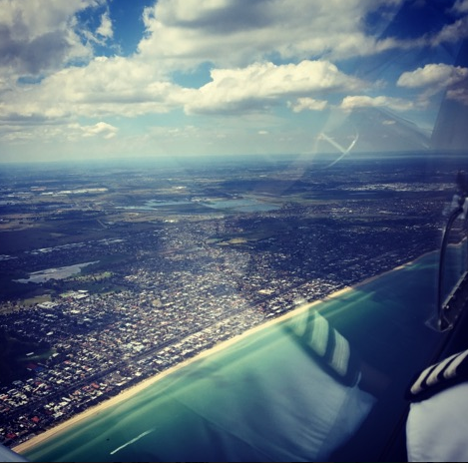
CLIMBING

Slide 2
OVERVIEW
Aim
Objectives
Revision
Definitions
Forces in a Climb
Types of Climb
Factors affecting Climb Performance
Application
Airmanship/Threat and Error Management
Revision Questions

Slide 3
AIM
To understand the aerodynamic principles and practical applications how to correctly enter, maintain and exit a climb

Slide 4
OBJECTIVES
Describe the interaction of the four forces during a climb
State the effect on climb rate and angle when subject the following factors:
Weight
Flaps
Headwind/tailwind
Power
Density
State the procedure in entering, maintaining and exiting a climb
Identify threats associated with climbing the aircraft

Slide 5
REVISION

Slide 6
REVISION
State the four forces in straight and level flight. Which forces act equal to each other in order to achieve equilibrium?
Lift, Drag, Thrust and Weight
Lift = Weight Thrust = Drag
2. State the two types of drag
Induced and Parasite (Form, Skin Friction and Interference)
3. State the normal cruise configuration
4800 RPM, Four Fingers, 95 knots
4. State the Maintenance Cycle
Attitude, Lookout, Attitude, Performance

Slide 7
DEFINITIONS

Slide 8
DEFINITIONS
Best Rate of Climb (RoC) Vy: Highest vertical speed of the aeroplane in feet per minute (ft/min)
Best Angle of Climb (AoC) Vx: Highest vertical height in the shortest ground distance (ft/nm)
Power: Rate of doing work. Power = Thrust x Speed
Groundspeed: Speed of the aeroplane over the ground
Service Ceiling: Altitude at which the aircraft can only maintain a climb of 100ft/min
Absolute Ceiling: Altitude at which the aircraft can no longer climb

Slide 9
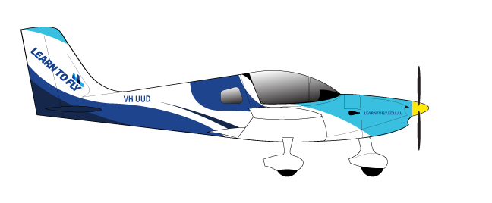
DEFINITIONS
Elapsed Time is 1 minute
Best Angle of Climb
Best Rate of Climb
Vx
Vy
Vcrz
Altitude gained
Distance traveled

Slide 10
PRINCIPLES
PRINCIPLES

Slide 11
FORCES OF
STRAIGHT AND LEVEL
REVISION
COUPLED MOMENTS: Caused by the interaction of two moments connected by the horizontal distances, thus creating a twisting force.
Horizontal stabilizer down force
Lift
Total Drag
Thrust
Horizontal stabilizer
down force
L/W couple
T/D couple
Weight

Slide 12
PRINCIPLES
FORCES IN A STEADY CLIMB
In a climb:
L is less than W
Ta
Tr
L
Tr needs to overcome Total Drag
During a climb it’s the excess thrust which overcomes the W2 component of weight.
Te
Dt
Total Drag
W₁
W
RCW

Slide 13
PRINCIPLES
TYPES OF CLIMB

Slide 14
PRINCIPLES
BEST ANGLE OF CLIMB
Maximum excess thrust
Best height to horizontal distance ratio
Occurs when maximum excess thrust occurs, the difference between thrust output and total drag
Primarily used for obstacle clearance after take-off
Poor forward visibility and poor engine cooling
SLG2 65 KNOTS
THRUST
THRUST REQUIRED
THRUST AVAILABLE
Vx
Vy
Cruise climb
IAS

Slide 15
PRINCIPLES
BEST RATE OF CLIMB
POWER REQUIRED
Best height to time ratio
Occurs at maximum excess power
Primary used for take-off or if a quick climb is necessary
Slightly better forward visibility and engine cooling
SLG2 72 KNOTS
Maximum excess HP
POWER AVAILABLE
HP
Vx
Vy
Cruise Climb
IAS

Slide 16
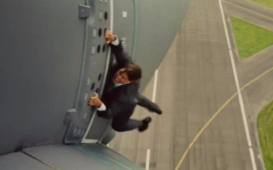
PRINCIPLES
CRUISE CLIMB
Compromise between rate and speed
Used for most climbs if best angle or rate is not essential
No defined speed in Flight Manual
Allows for engine cooling and provides good forward visibility
SLG2 85 KNOTS

Slide 17
TYPES OF CLIMB
Elapsed Time is 1 minute
Best Angle of Climb
Best Rate of Climb
Vx: 65 kts
Vy: 72 kts
Cruise Climb
V: 85 kts
Altitude gained
Distance traveled

Slide 18
FACTORS AND CONSIDERATIONS
FACTORS AFFECTING CLIMB

Slide 19
FACTORS AND CONSIDERATIONS
WEIGHT
Increased weight means lift must be increased to maintain the aircraft in a balanced condition.
Extra lift increases the drag, reducing the amount of excess thrust and power available.
Maximum excess HP
Power required
Maximum excess thrust
Power available
HP
Thrust required
THRUST
Thrust available
Vx
Vy
IAS
Vx
Vy
Cruise climb
IAS

Slide 20
DENSITY
FACTORS AND CONSIDERATIONS
ALTITUDE
As altitude increases the outside air density decreases
Therefore, there is less power available, reducing climb performance.
Propeller becomes less efficient further reducing the thrust available
Maximum excess HP
Power required
Maximum excess thrust
Power available
HP
Thrust required
THRUST
Thrust available
Vx
Vy
Cruise Climb
IAS
Vx
Vy
Cruise climb
IAS
TEMPERATURE/HUMIDITY
Increasing either temperature or humidity also decreases the air density
Having the same effect on climb performance as increasing altitude

Slide 21
FACTORS AND CONSIDERATIONS
WIND
At a constant airspeed the rate of climb is unaffected by wind. The angle of climb, however, is increased when climbing into a headwind and reduced when climbing into a tailwind.
For the same airspeed and power, all three aeroplanes reach this height in the same time interval
500ft
NIL WIND
HEADWIND
TAILDWIND

Slide 22
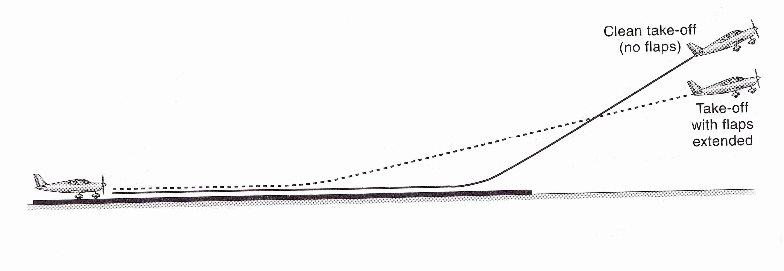
FACTORS AND CONSIDERATIONS
FLAPS
Used in take-off to produce a large lift force with an additional small drag force
Reduces take off distance required however reduces both angle of climb and rate of climb

Slide 23
FACTORS AND CONSIDERATIONS
POWER
Decrease in power
Decrease in angle of climb
Decrease in rate of climb
Maximum excess HP
Power required
Power available
HP
NOTE: all climbs in SLG2 are done at full throttle
Vx
Vy
Cruise Climb
IAS

Slide 24
SUMMARY
FACTORS AND CONSIDERATIONS
FACTOR | RATE OF CLIMB | ANGLE OF CLIMB
INCREASE POWER
DECREASE DENSITY INCREASE HEIGHT
INCREASE WEIGHT
HEADWIND
TAILWIND
DEPLOY FLAPS

Slide 25
APPLICATION

Slide 26
APPLICATION
PRE ENTRY CHECKS
Heading SELECT HEADING (HDG)
Altitude SELECT ALTITUDE (ALT)
Lookout

Slide 27
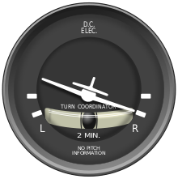
APPLICATION
Entry
Power FULL THROTTLE
Attitude SET as required
Speed Wait for speed to stabilise
Trim TRIM the aircraft
Increase in power causes a yaw left
Step on the right rudder pedal to prevent yaw

Slide 28
APPLICATION
Work Cycle
ATTITUDE
LOOKOUT
ATTITUDE
PERFORMANCE
LOOKCOOL Checks
Every 1000 feet, lower the nose for lookout and cool the engine

Slide 29
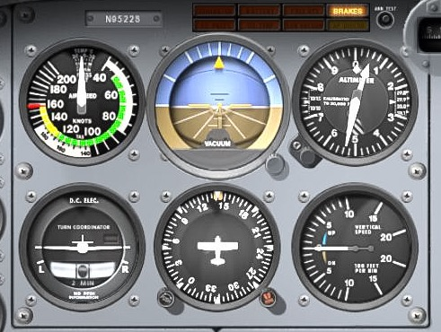
APPLICATION
Performance

Slide 30
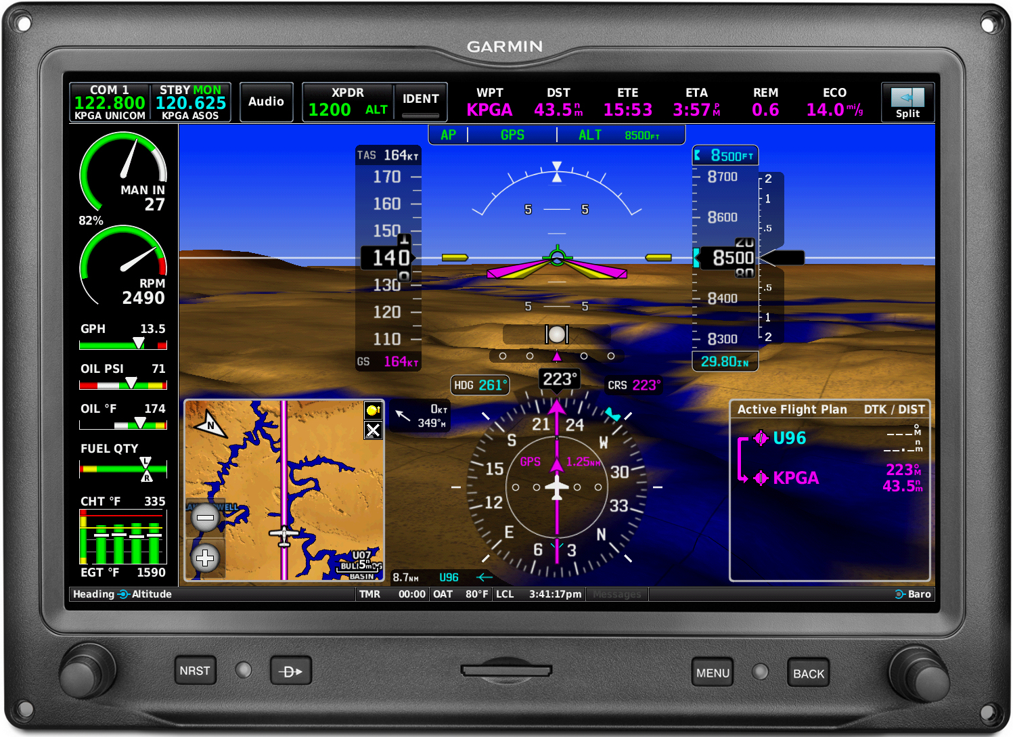
PERFORMANCE
APPLICATION

Slide 31
BALANCE
APPLICATION
AIRCRAFT SHOULD ALWAYS BE BALANCED

Slide 32
APPLICATION
Levelling Off
APPLICATION
Anticipate level off by 10%
Attitude Set the attitude
Speed Allow the speed to increase to required speed
Power Reduce power back to cruise
Trim Trim aircraft for ‘hands off’

Slide 33
APPLICATION
Attitude
Speed
Power
Trim
Pre-entry
Choose reference point
Heading
Altitude
Lookout
Attitude Lookout Attitude Performance
Power
Attitude
Speed
Trim

Slide 34
APPLICATION
POWER SETTINGS
PAST | Best Angle Climb | Best Rate Climb | Cruise Climb
Power | FULL | FULL | FULL
Attitude | Cowling four fingers above the horizon | Cowling two fingers above horizon | Cowling on horizon
Speed | 65 knots | 72 knots | 85 knots
Trim | TRIM for Hands Off State

Slide 35
AIRMANSHIP
LOOKOUT: Maintain proper lookout (clock code)
WORK CYCLE: Maintain a constant and correct work cycle
CONTROL HANDLING: Smooth applications on the controls and throttle
Handover & Takeover Procedures: Verbalise
TRIM: Make sure you trim the aircraft

Slide 36
THREAT AND ERROR MANAGEMENT
THREAT | ERROR | MANAGEMENT
Improper use of maintenance cycle
LOOKCOOL procedure
Reduced forward visibility
Overstressing the engine
Rough handling of throttle
Smooth applications
Stalling
Pulling back on the control stick too much and not checking airspeed
Maintain speed during climb

Slide 37
REVISION QUESTIONS
Describe the interaction of the four forces during a climb
State the effect on climb rate and angle when subject the following factors:
Weight
Flaps
Headwind/tailwind
Power
Density
State the procedure in entering, maintaining and exiting a climb
Identify threats associated with climbing the aircraft

